Slide 1
K Nearest Neighbors

Slide 2
Learning Goals
In this section, we will cover:
- The K Nearest Neighbors (KNN) approach for Classification
- The KNN decision boundary
- Distance measurement and the importance of Feature Scaling
- Implementation of KNN for both Classification and Regression

Slide 3
Introduction to The K Nearest Neighbors
K Nearest Neighbour (KNN) is one of the simplest Machine Learning algorithms based on Supervised Learning technique.
KNN algorithm assumes the similarity between the new case/data and available cases and put the new case into the category that is most similar to the available categories.
KNN algorithm stores all the available data and classifies a new data point based on the similarity. This means when new data appears then it can be easily classified into a well suite category by using KNN algorithm.
KNN algorithm can be used for Regression as well as for Classification but mostly it is used for the Classification problems.

Slide 4
Introduction to The K Nearest Neighbors
KNN is a non-parametric algorithm, which means it does not make any assumption on underlying data.
It is also called a lazy learner algorithm because it does not learn from the training set immediately instead it stores the dataset and at the time of classification, it performs an action on the dataset. Some alternative names:
Instance based learning
Lazy learning
Memory based learning
KNN algorithm at the training phase just stores the dataset and when it gets new data, then it classifies that data into a category that is much similar to the new data.

Slide 5
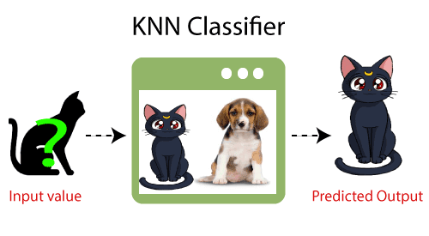
Introduction to The K Nearest Neighbors
Example: Suppose, we have an image of a creature that looks similar to cat and dog, but we want to know either it is a cat or dog. So for this identification, we can use the KNN algorithm, as it works on a similarity measure. Our KNN model will find the similar features of the new data set to the cats and dogs images and based on the most similar features it will put it in either cat or dog category.

Slide 6
How does KNN work?
Step 1 − choose the value of K i.e. the nearest data points. K can be any integer.
Step 2 − For each point in the test data do the following:
2.1 − Calculate the distance between test data and each row of training data with the help of any of the method namely: Euclidean, Manhattan or Hamming distance. The most commonly used method to calculate distance is Euclidean.
2.2 − Based on the distance value, sort them in ascending order.
2.3 − Choose the top K rows from the sorted array.
2.4 − Assign a class to the test point based on most frequent class of these rows.
Step 3 − End

Slide 7
KNN Overview
Pros:
It is very simple algorithm to understand and interpret.
It is very useful for nonlinear data because there is no assumption about data in this algorithm.
It is a versatile algorithm as we can use it for classification as well as regression.
It has relatively high accuracy but there are much better supervised learning models than KNN.
Cons:
It is computationally a bit expensive algorithm because it stores all the training data.
High memory storage required as compared to other supervised learning algorithms.
Prediction is slow in case of big N.
It is very sensitive to the scale of data as well as irrelevant features.

Slide 8
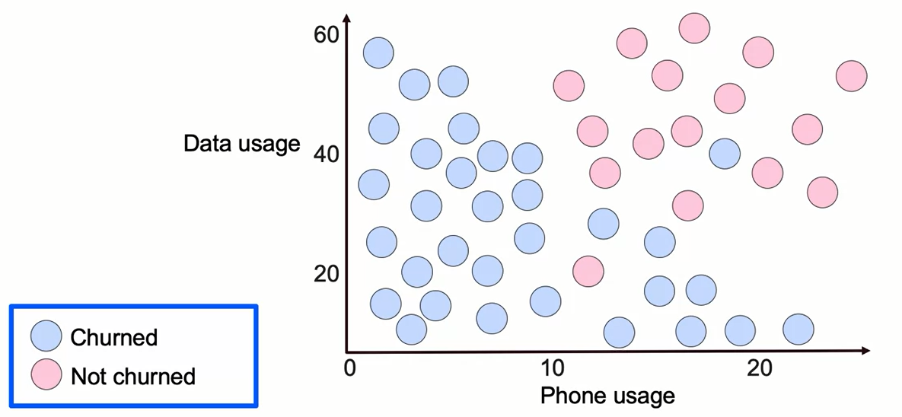
K Nearest Neighbors Classification

Slide 9
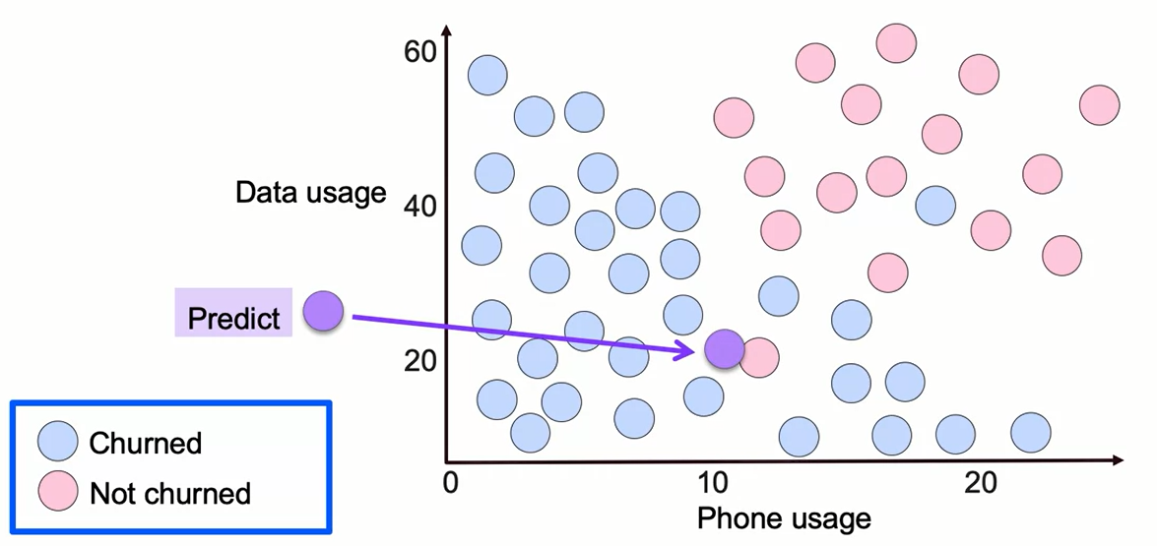
K Nearest Neighbors Classification

Slide 10
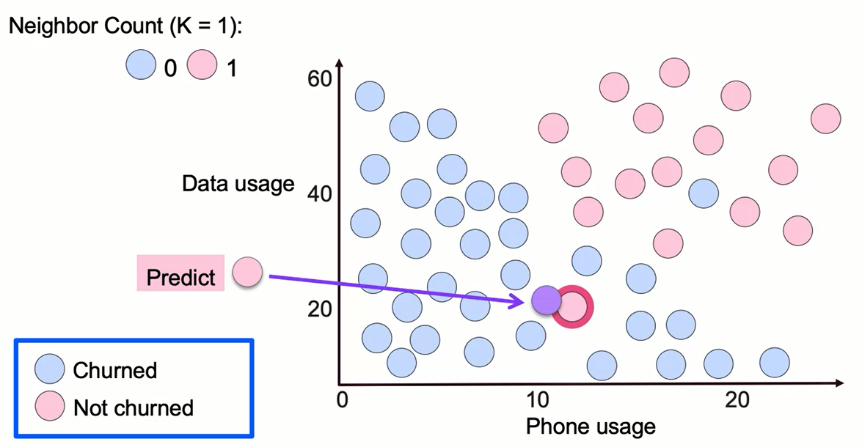
K Nearest Neighbors Classification

Slide 11
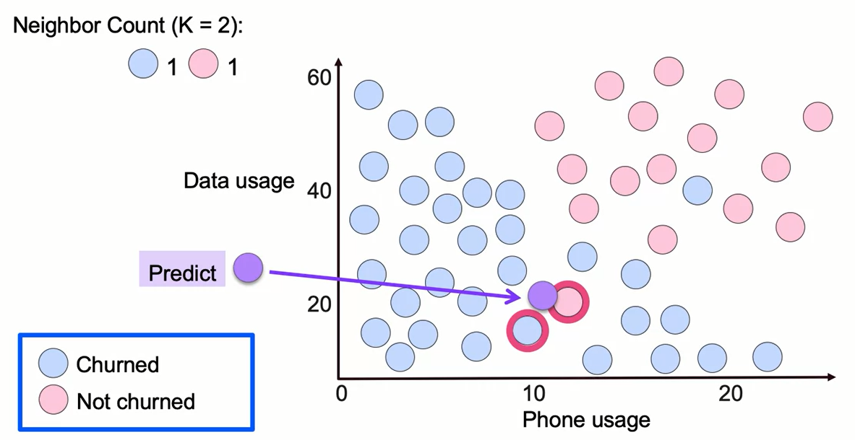
K Nearest Neighbors Classification

Slide 12
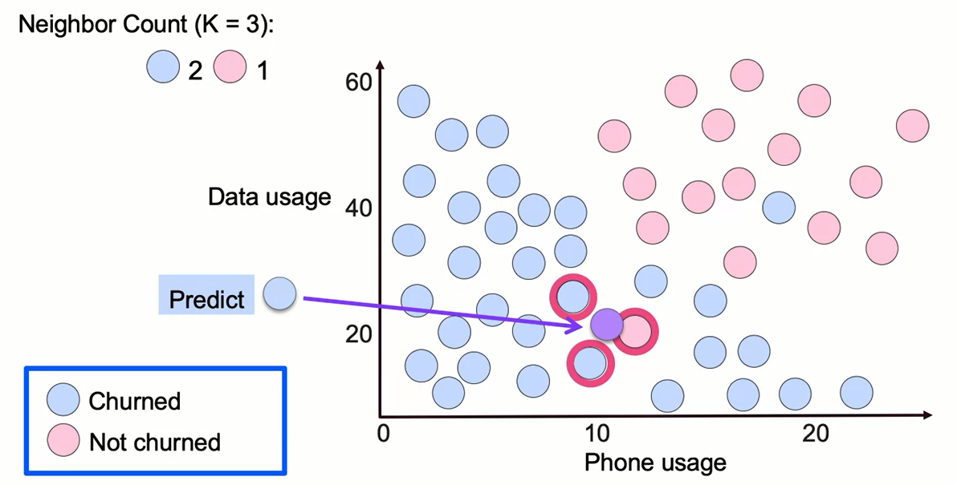
K Nearest Neighbors Classification

Slide 13
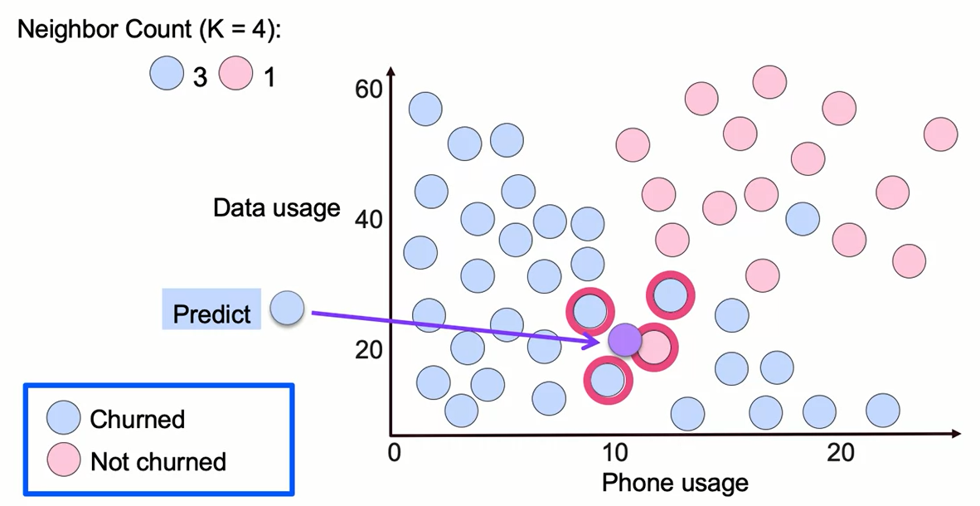
K Nearest Neighbors Classification

Slide 14
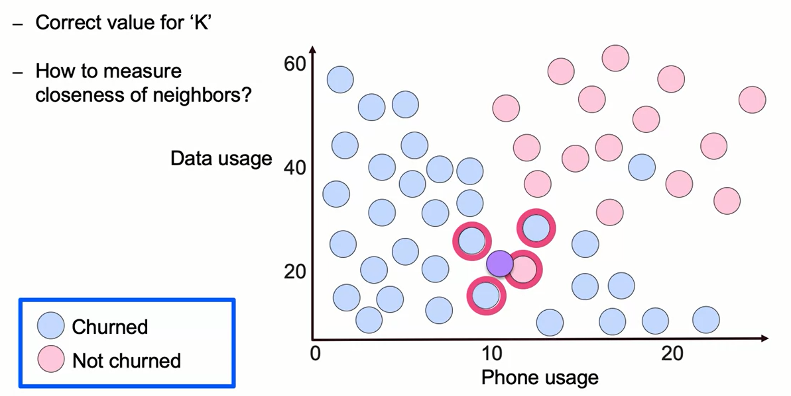
What is Needed to Select a KNN Model?

Slide 15
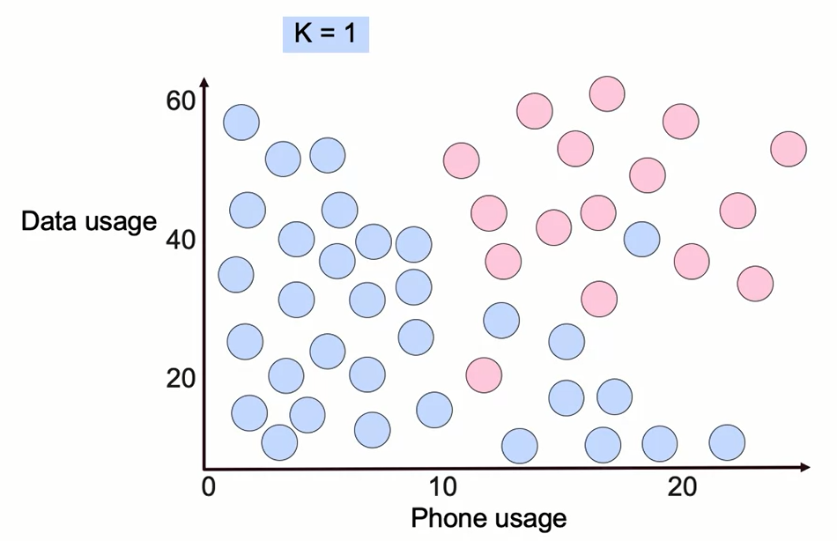
K Nearest Neighbors Decision Boundary

Slide 16
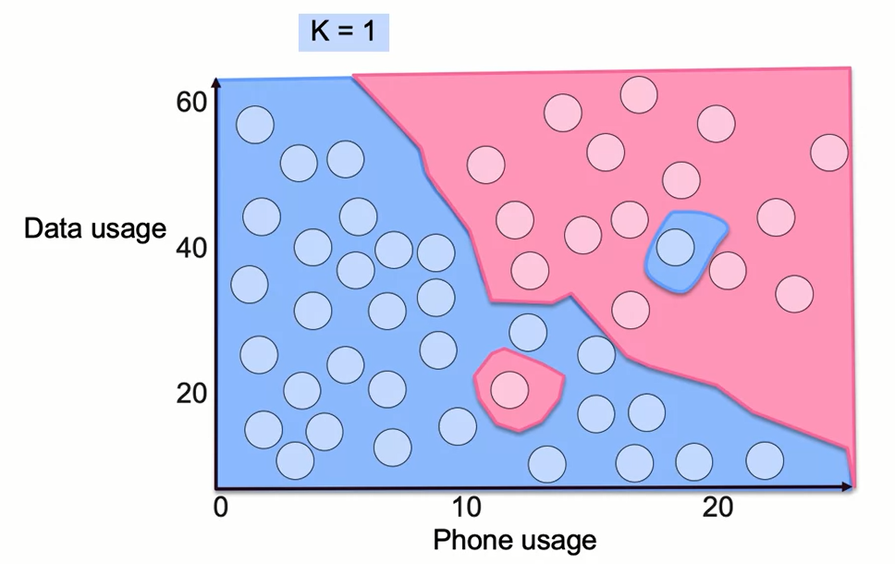
K Nearest Neighbors Decision Boundary

Slide 17
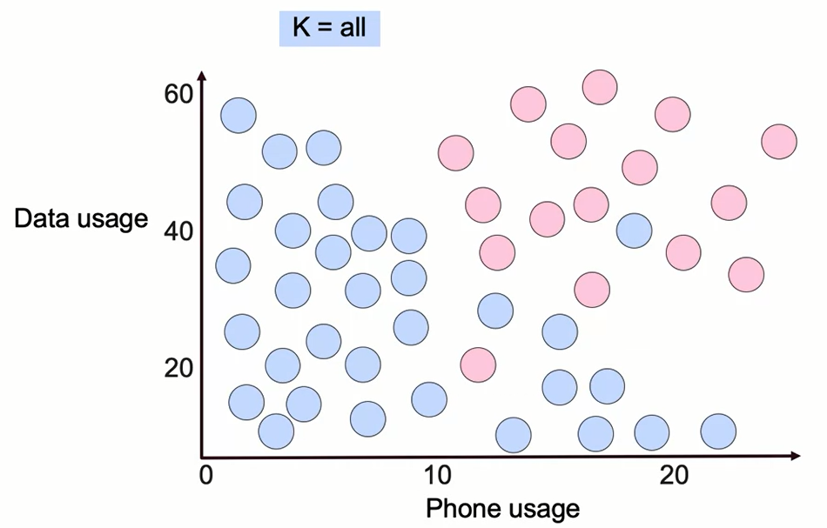
K Nearest Neighbors Decision Boundary

Slide 18
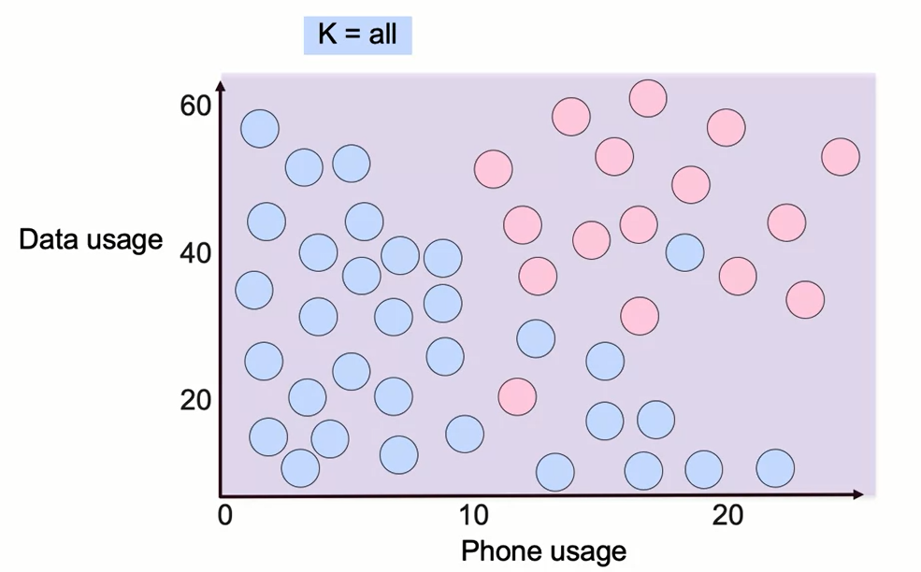
K Nearest Neighbors Decision Boundary

Slide 19
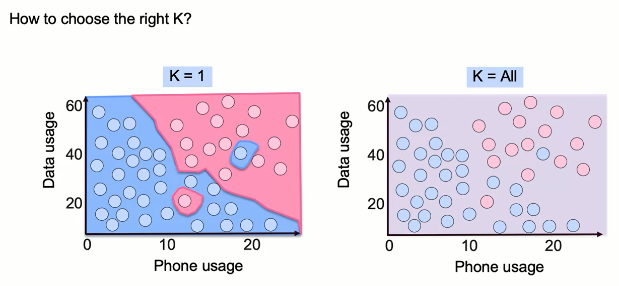
K Nearest Neighbors Decision Boundary

Slide 20
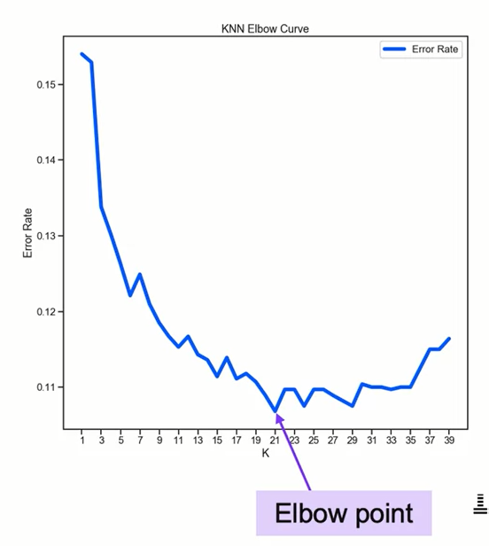
K Nearest Neighbors Decision Boundary
Choosing the right value for K
- KNN does not provide a 'correct' K.
- The right value depends on which error metric is most important
- A common approach is to use an 'elbow method approach
- This emphasizes kinks in a curve of the error rate as a function of K
- Beyond this point, the rate of improvement slows or stops

Slide 21
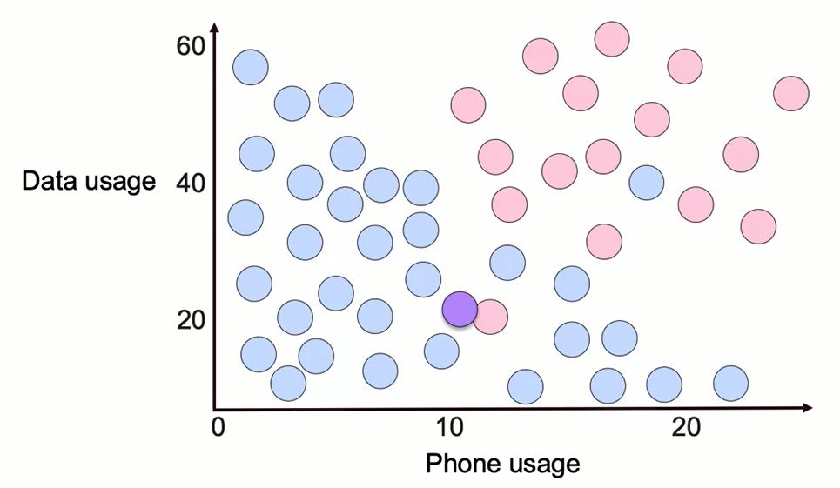
Measurement of Distance in KNN

Slide 22
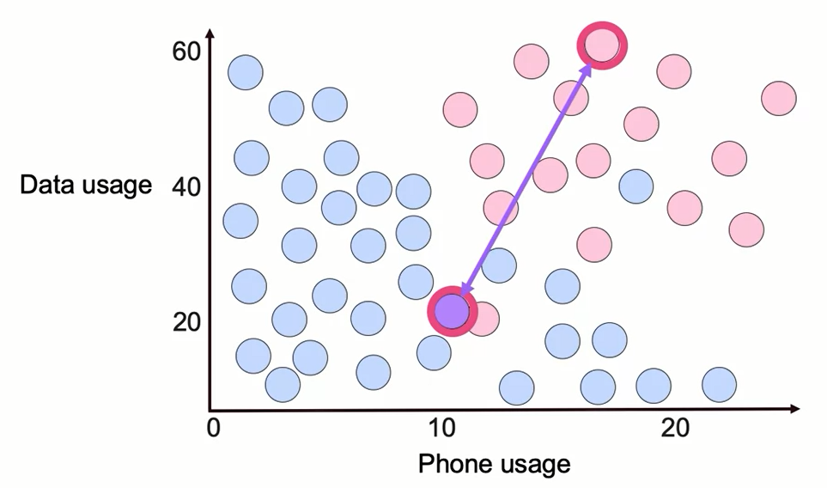
Measurement of Distance in KNN

Slide 23
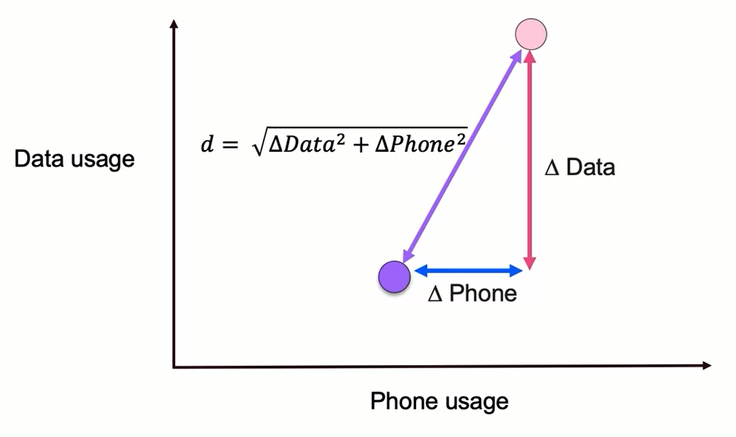
Euclidean Distance (L2)

Slide 24
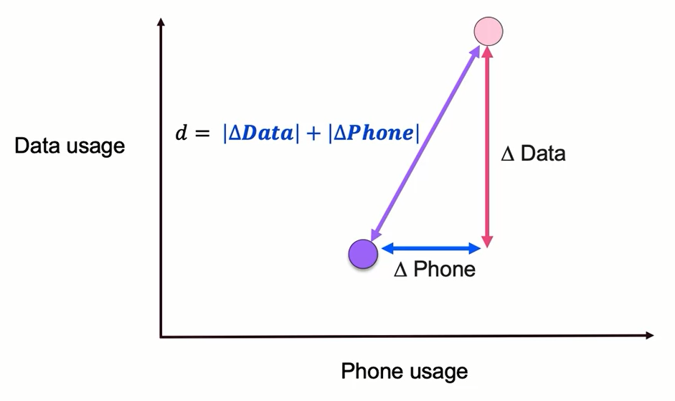
Manhattan Distance (L1)

Slide 25
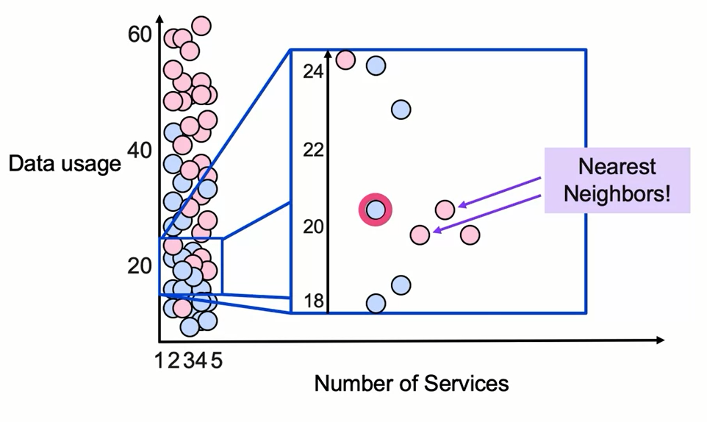
Scale for Distance Measurement

Slide 26
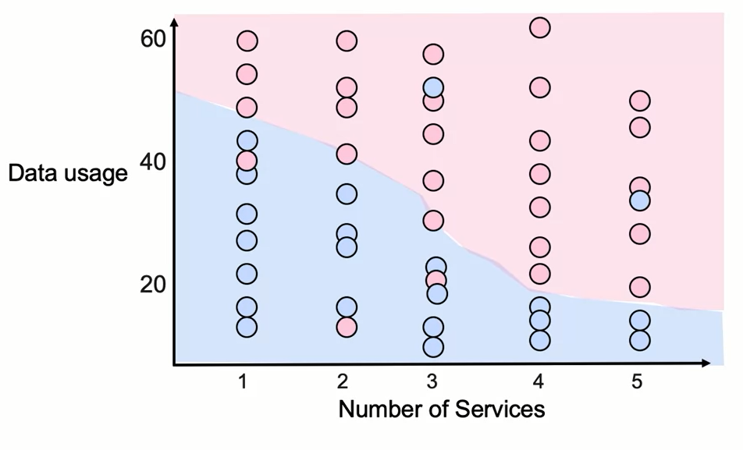
Feature Scaling

Slide 27
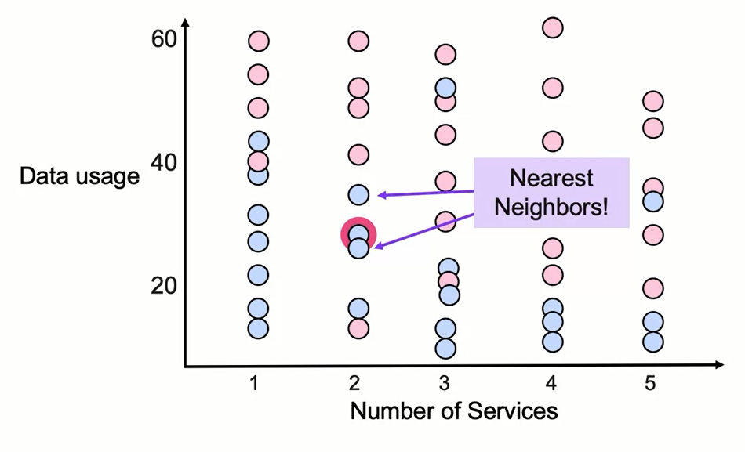
Feature Scaling

Slide 28
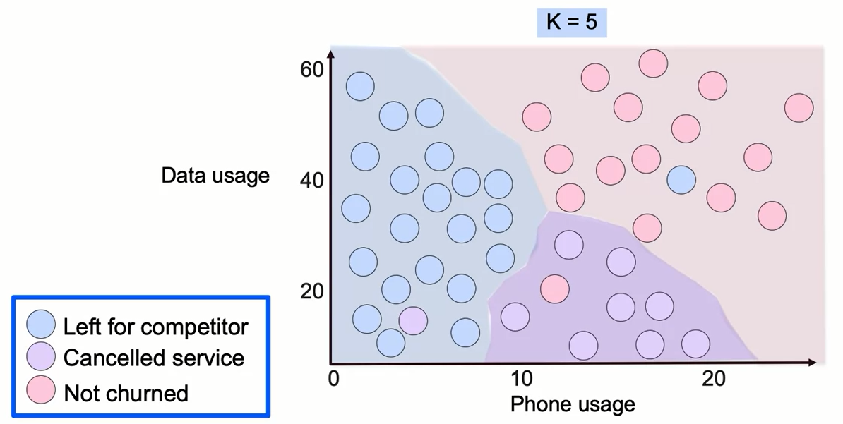
K Nearest Neighbors Decision Boundary

Slide 29
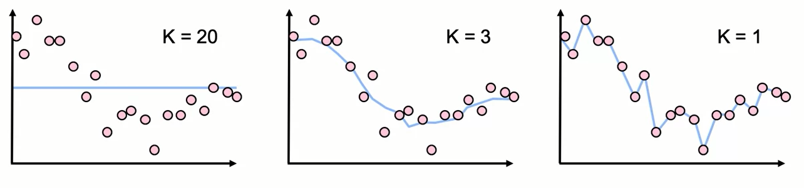
Regression with KNN

Slide 30
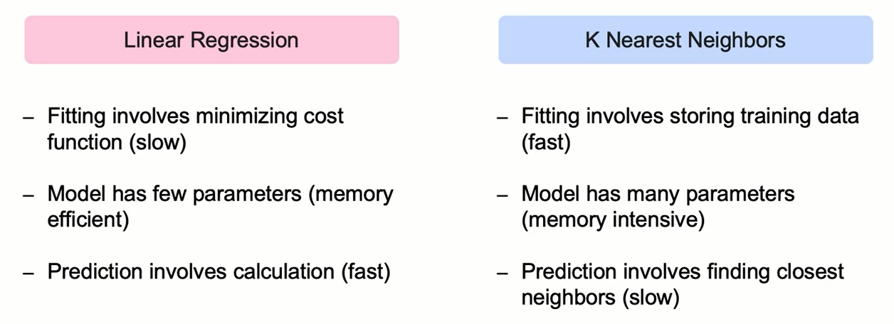
Characteristics of a KNN Model

Slide 31
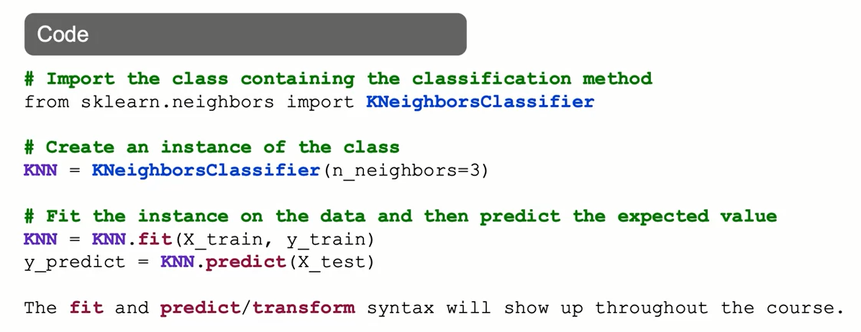
K Nearest Neighbors: The Syntax

Slide 32
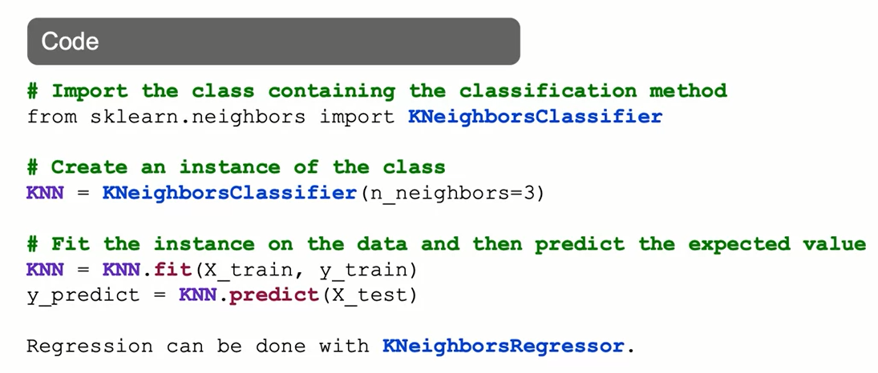
K Nearest Neighbors: The Syntax

Slide 33
Summary
K Nearest Neighbor Methods for Classification
K nearest neighbor methods are useful for classification. The elbow method is frequently used to identify a model with low K and low error rate.
These methods are popular due to their easy computation and interpretability, although it might take time scoring new observations, it lacks estimators, and might not be suited for large data sets.

Slide 34
Learning Recap
In this section, we discussed:
- The K Nearest Neighbors (KNN) approach for Classification
- The KNN decision boundary
- Distance measurement and the importance of Feature Scaling
- Implementation of KNN for both Classification and Regression

